Slide 1
Week 16 Exercises: WIOT
Glenn A. Aguilar-Hernandez
April 19, 2o22

Slide 2
Today’s agenda
Time | Activity
15.20 – 15.25 | Part 1: Introduction
15.25 – 15.40 | Question 1 & 2
15.40 – 15.50 | Review Question 1&2
15.50- 16.00 | Part 2: Introduction
15.00 – 16.05 | Develop code
16.05 – 16.20 | Break
16.20 – 16.45 | Develop code
16.45 – 17.00 | Review code

Slide 3
Part 1: Introduction
 | E | WT |  | Y
E | 52 | 22 |  | 100
WT | 349 | 44 |  | 50
Figure 1. Waste input-output table

Slide 4
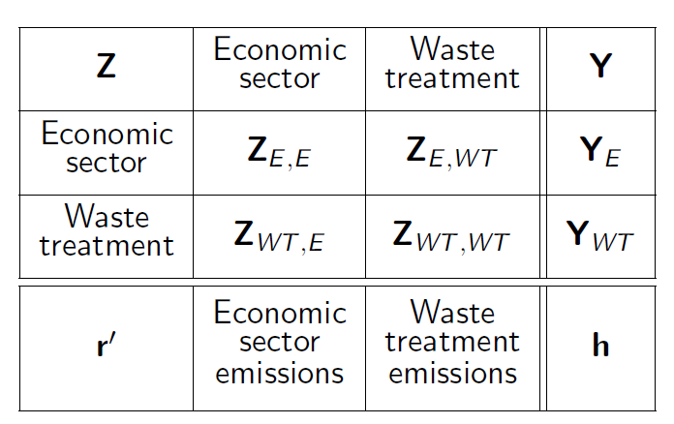
Part 2: Introduction
Figure 2. Basic structure WIOT

Slide 5
Review code
Let’s go to Python!

